Slide 1
Gender Recognition by Voice Decision Tree
By: Benjamin Wang

Slide 2
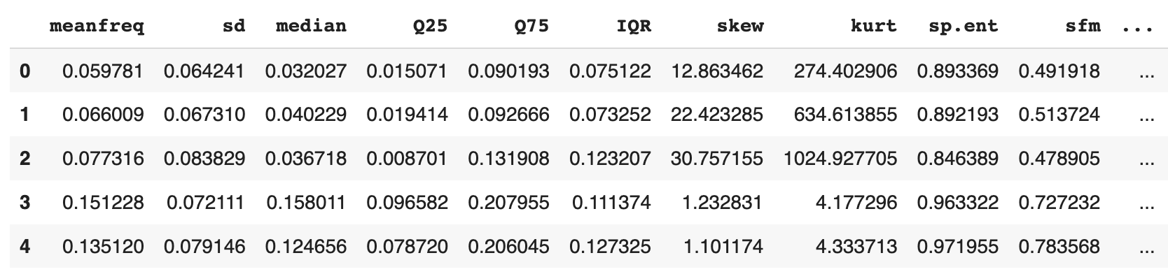
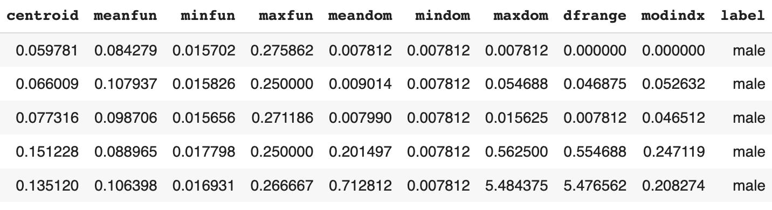
About the Dataset
Notes:
21 features and data points 3168, 50/50 split on male and female

Slide 3
Features Description
meanfreq: mean frequency (in kHz)
sd: standard deviation of frequency
median: median frequency (in kHz)
Q25: first quantile (in kHz)
Q75: third quantile (in kHz)
IQR: interquartile range (in kHz)
skew: skewness (see note in specprop description)
kurt: kurtosis (see note in specprop description)
sp.ent: spectral entropy
sfm: spectral flatness
mode: mode frequency
centroid: frequency centroid (see specprop)
peakf: peak frequency (frequency with highest energy)

Slide 4
Features Description Cont.
meanfun: average of fundamental frequency measured across acoustic signal
minfun: minimum fundamental frequency measured across acoustic signal
maxfun: maximum fundamental frequency measured across acoustic signal
meandom: average of dominant frequency measured across acoustic signal
mindom: minimum of dominant frequency measured across acoustic signal
maxdom: maximum of dominant frequency measured across acoustic signal
dfrange: range of dominant frequency measured across acoustic signal
modindx: modulation index. Calculated as the accumulated absolute difference between adjacent measurements of fundamental frequencies divided by the frequency range
label: male or female

Slide 5
01
Why this Dataset?

Slide 6
Can we Identify a person’s gender accurately through their voice features?

Slide 7
02
Data Manipulation & Visualization

Slide 8
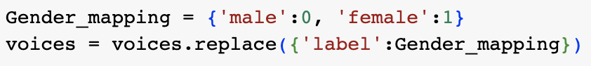
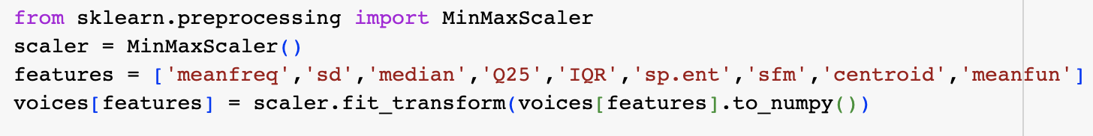
Data Cleaning
Replace ‘male’ and ‘female with 0 and 1 respectively
Normalize the data with Min-Max Scaler
Notes:
Min-Max Scaler - Normalization, Standard Scaler - Standardization
Normalization is considered when the algorithms do not make assumptions about the data distribution. Standardization is used when algorithms make assumptions about the data distribution.
Decision Trees are non-statistical so they do not make assumptions about the data distribution

Slide 9
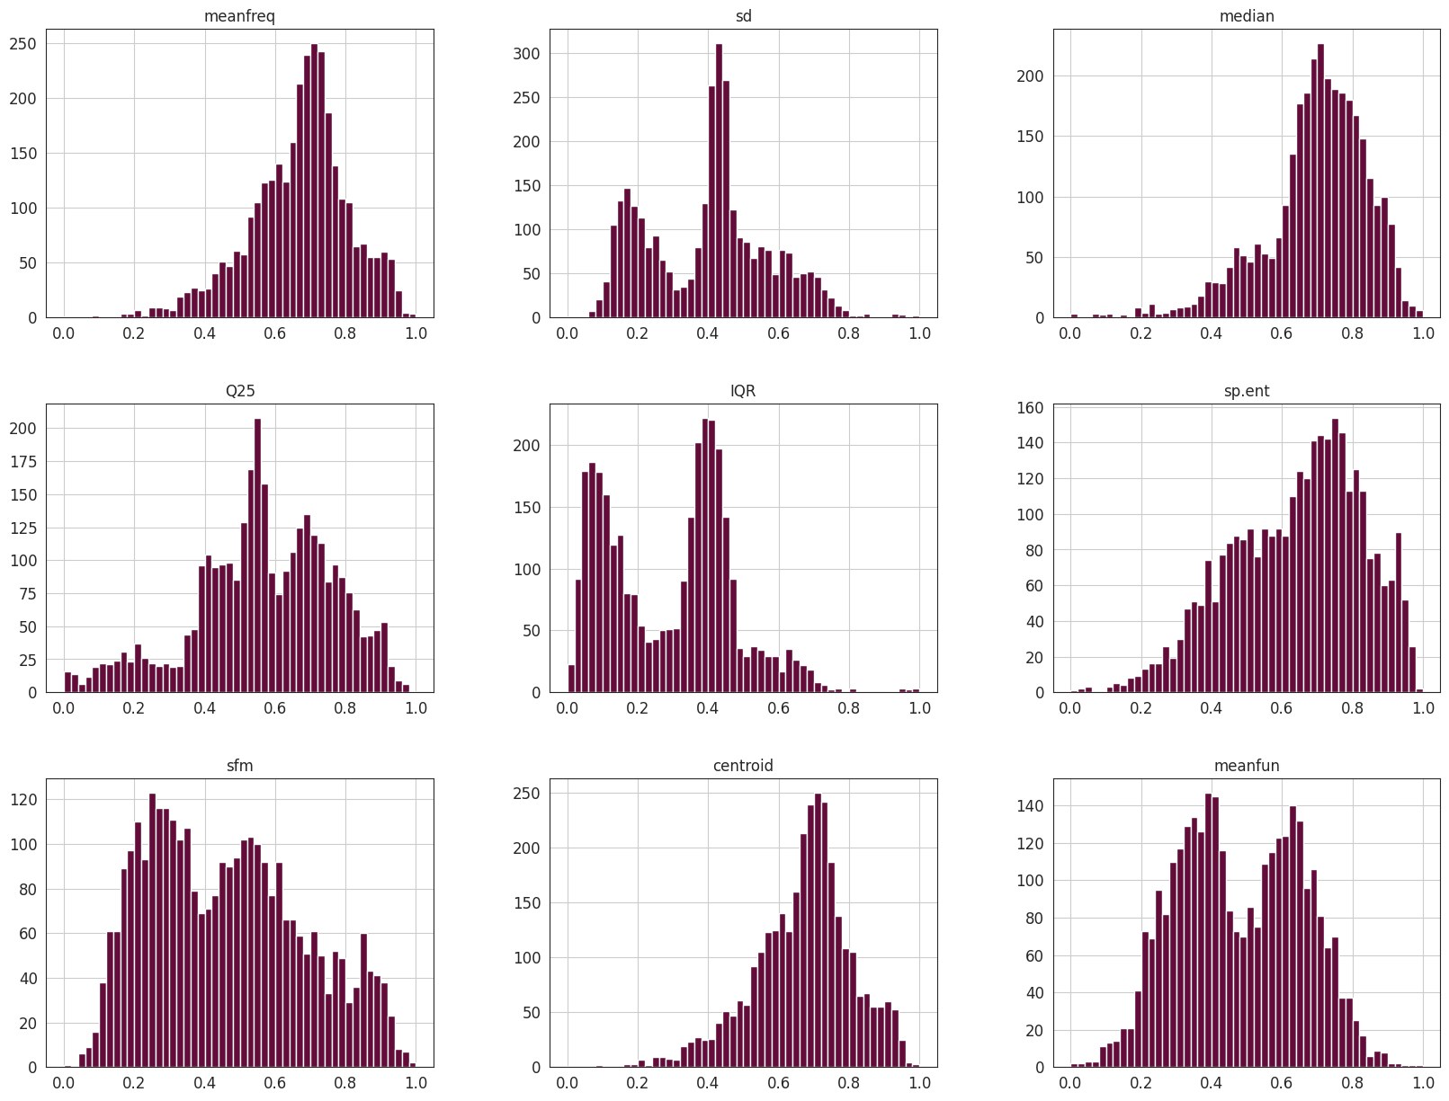

Slide 10
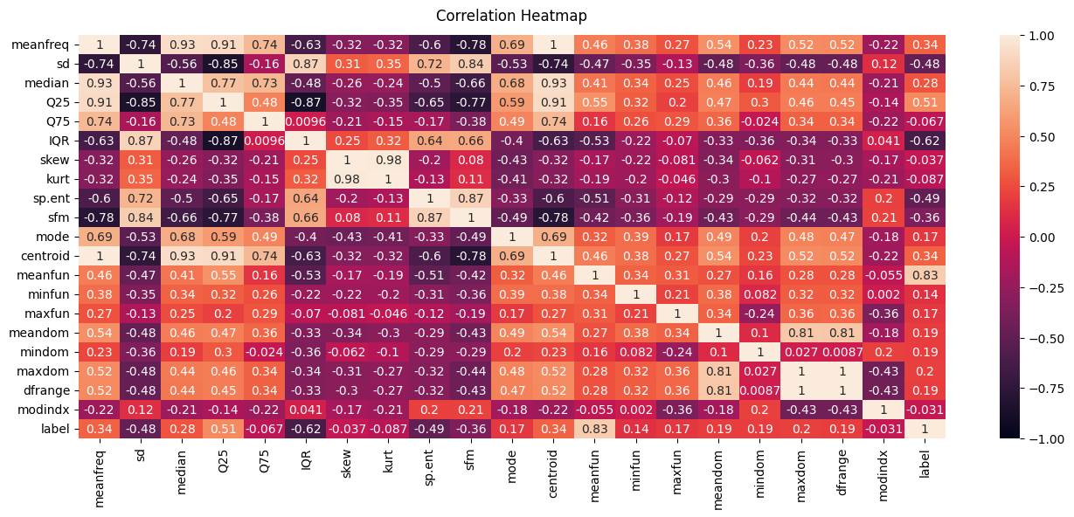

Slide 11
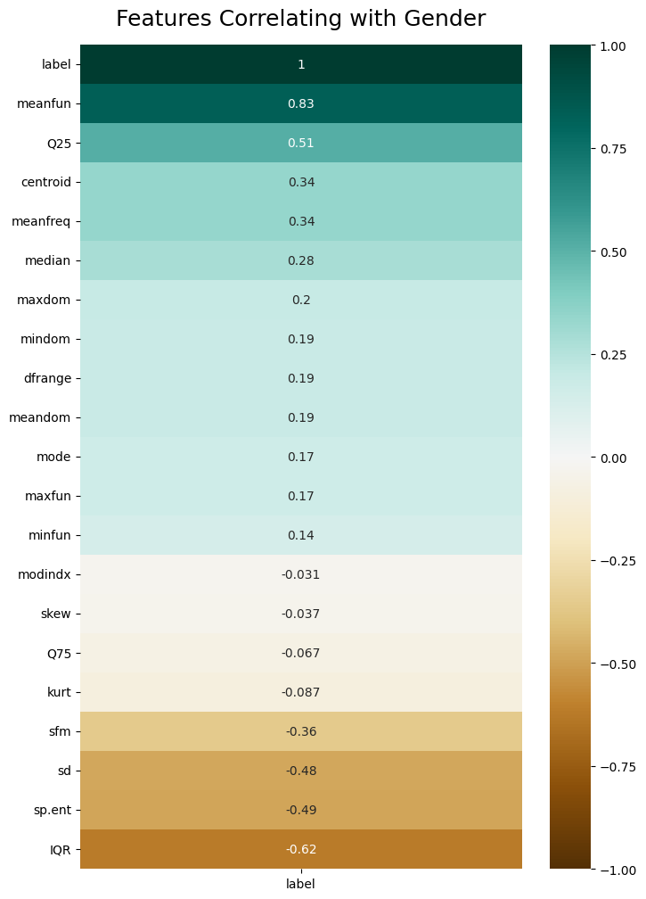
Correlation Heatmap
Features with Low Correlation:
Maxdom (0.2)
Mindom (0.19)
Dfrange (0.19)
Meandom (0.19)
Mode (0.17)
Maxfun (0.17)
Minfun (0.14)
Modindx (-0.031)
Skew (-0.037)
Q75 (-0.067)
Kurt (-0.087)

Slide 12
Using KNN to Identify Trends
2 Clusters without genders
2 Clusters with genders
5 Clusters with genders
Identify similarities between genders
Identify differences between genders
Identify differences among each genders own data

Slide 13
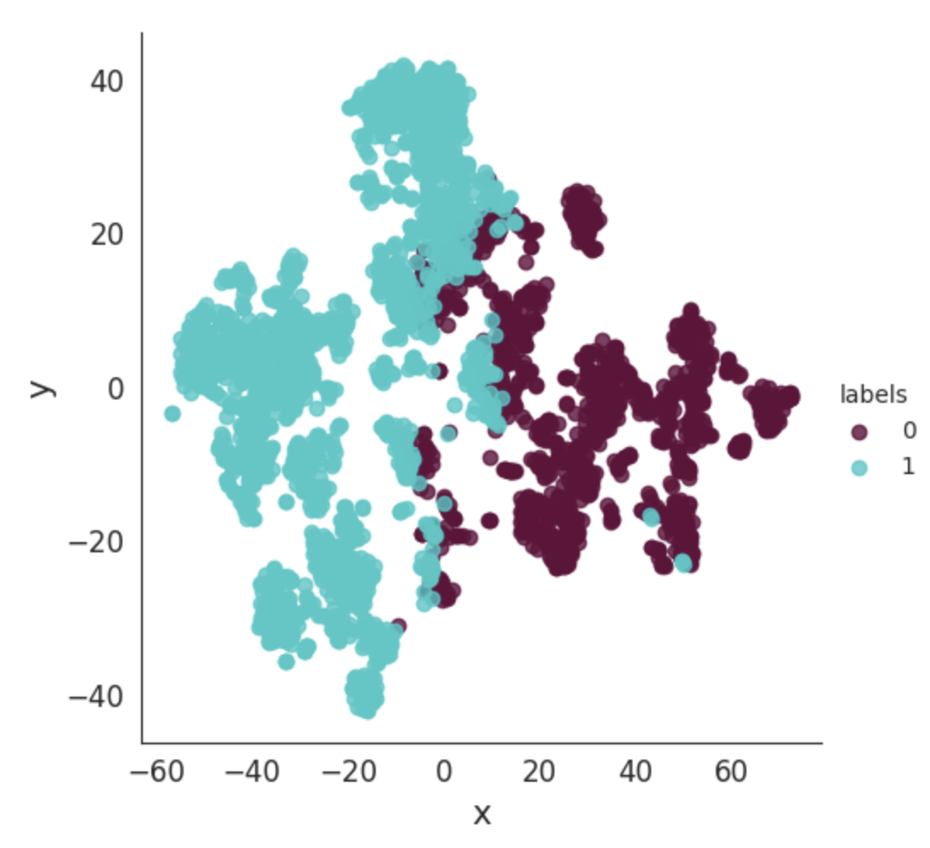
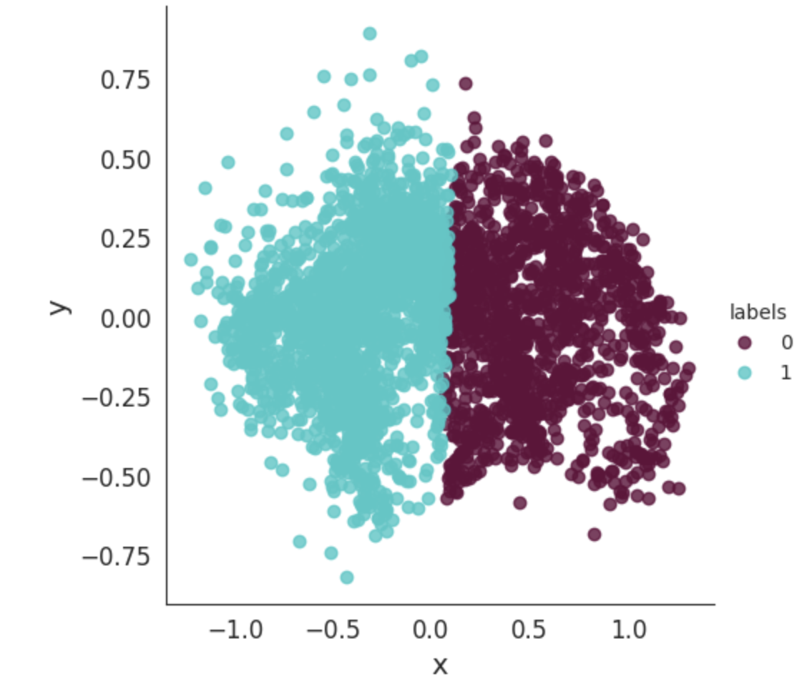
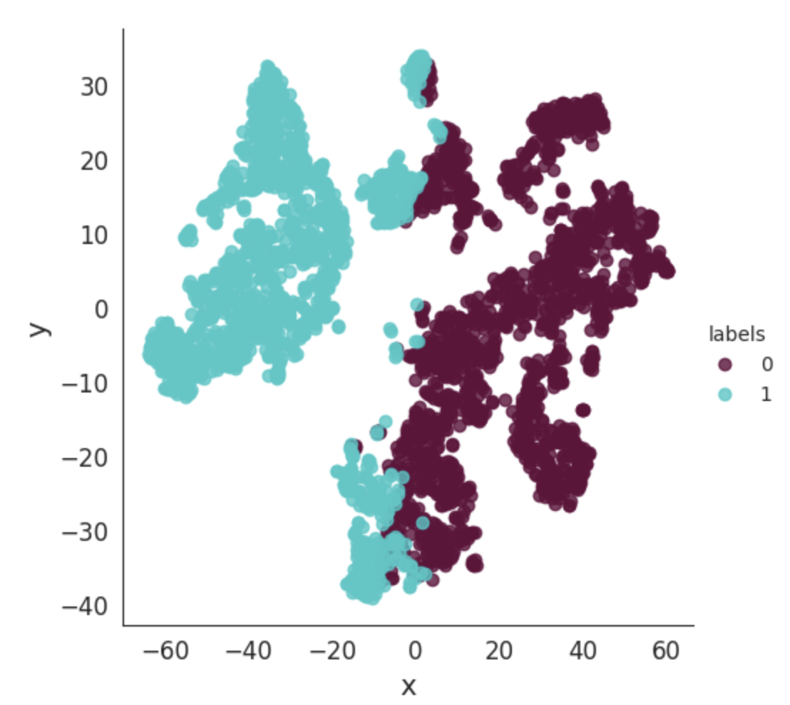
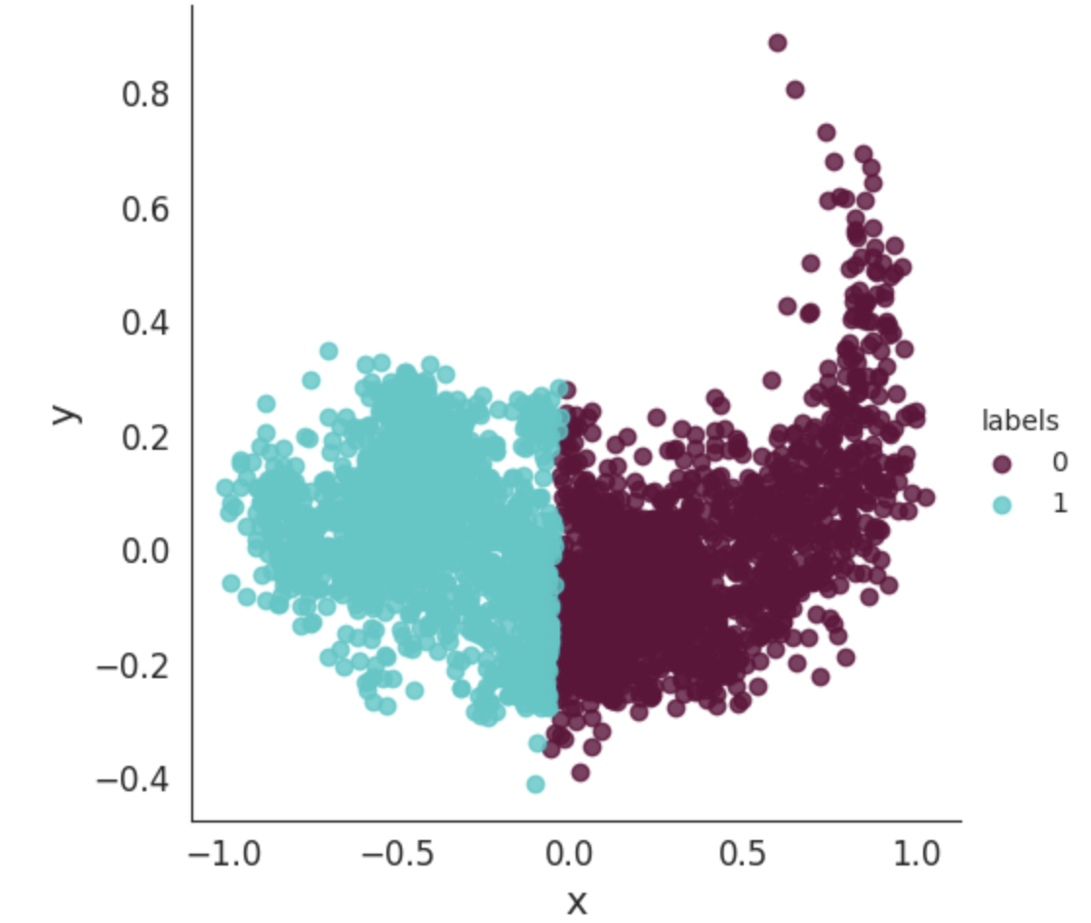
T-Distributed Stochastic Neighbor Embedding (TSNE)
Principal Component Analysis (PCA)

Slide 14
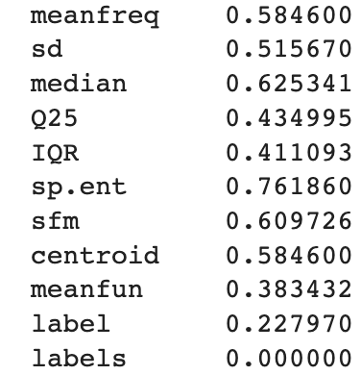
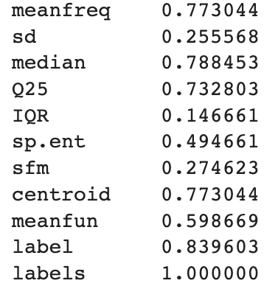
1759 Data Points
1409 Data Points
Notes:
Group 0, 387 Female and 1372 Male
Group 1, 1182 Female and 227
Biggest differences sd 0.26, sp.ent 0.27 (spectral entropy), and sfm 0.33 (spectral flatness)
Spectral flatness is a measure used in digital signal processing to characterize an audio spectrum. High sfm means that overall the power in the sound is even throughout the spectrum, approaching 1 means white noise. While low spectral flatness approaching 0, pure tone, sound is concentrated in small number of bands causing it to be spikey
Spectral entropy is a measure of its spectral power distribution is the measure of signal’s power content versus frequency

Slide 15
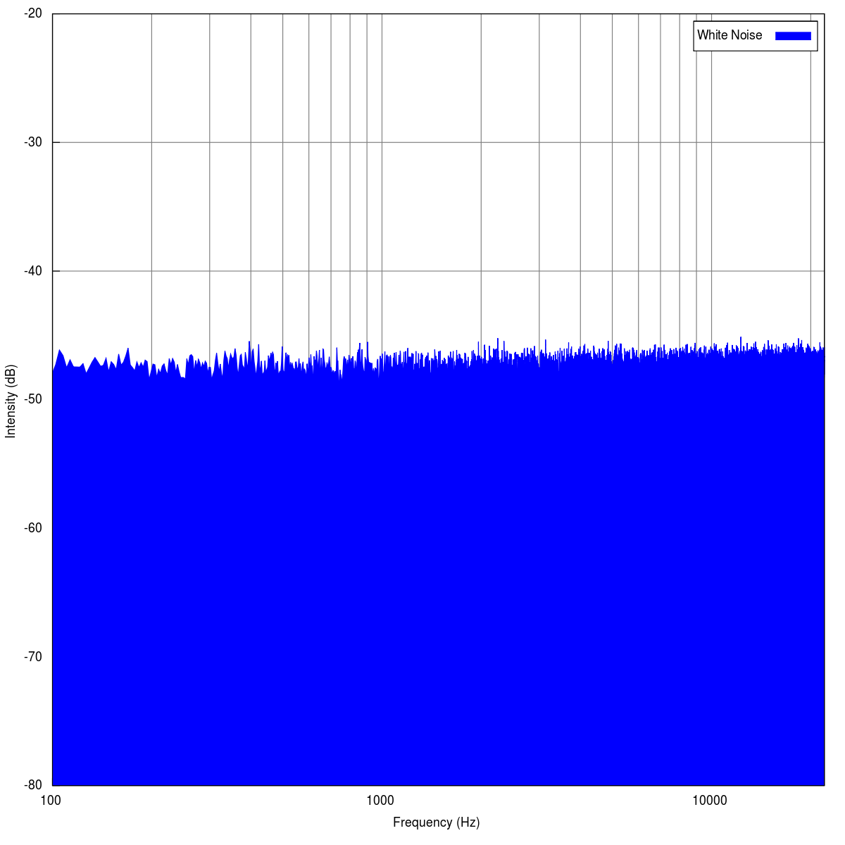
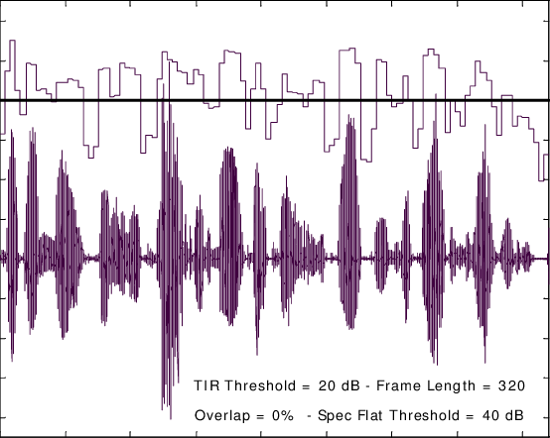
Low Spectral Flatness
High Spectral Flatness

Slide 16
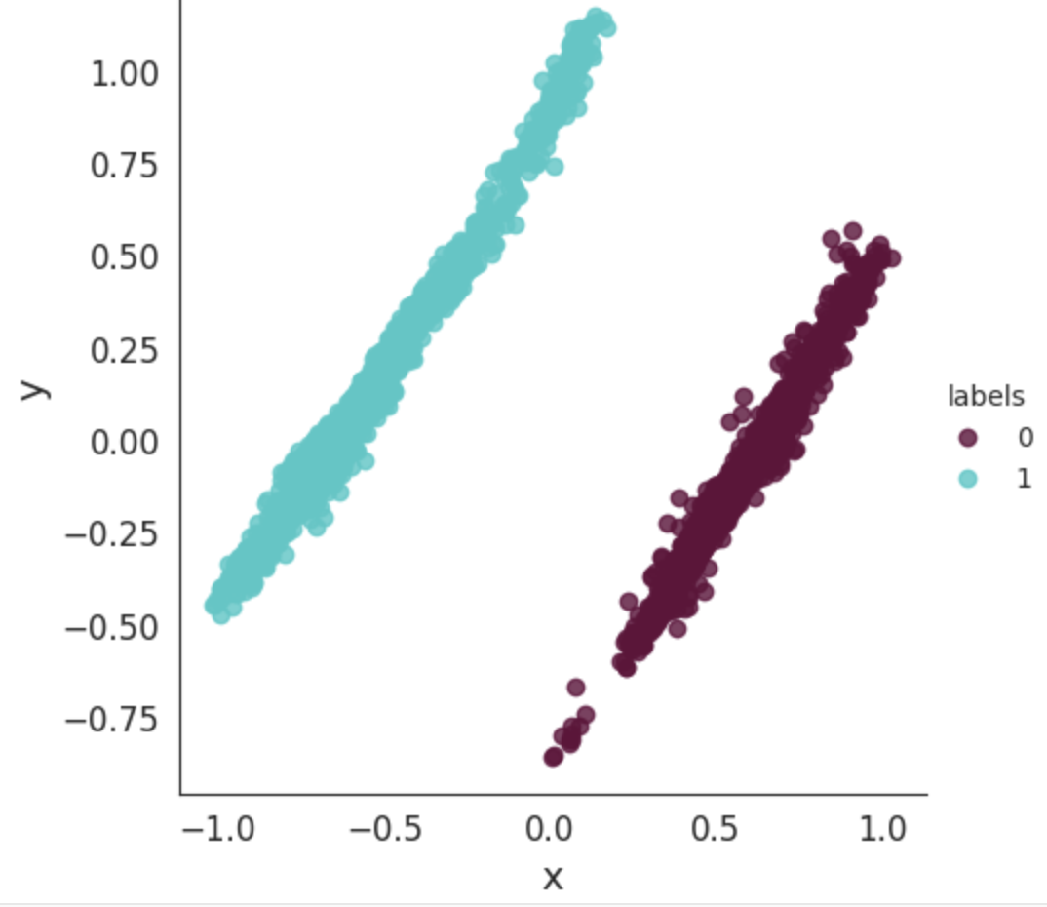
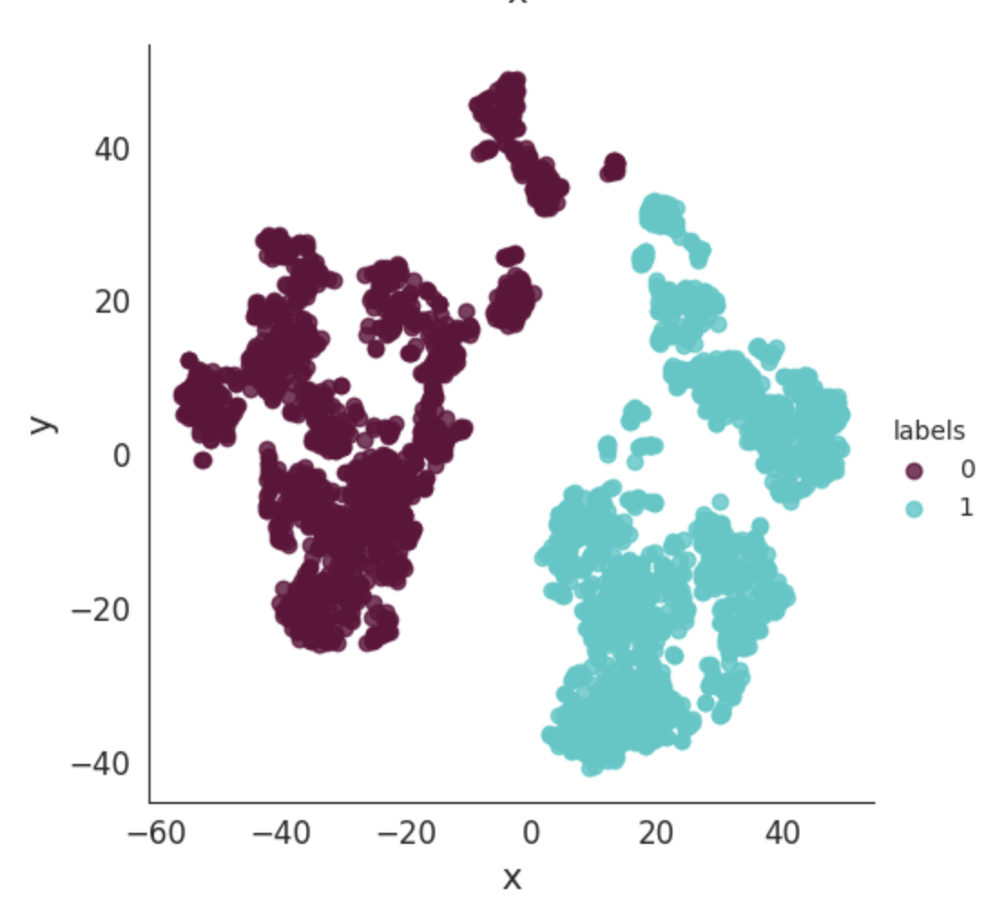
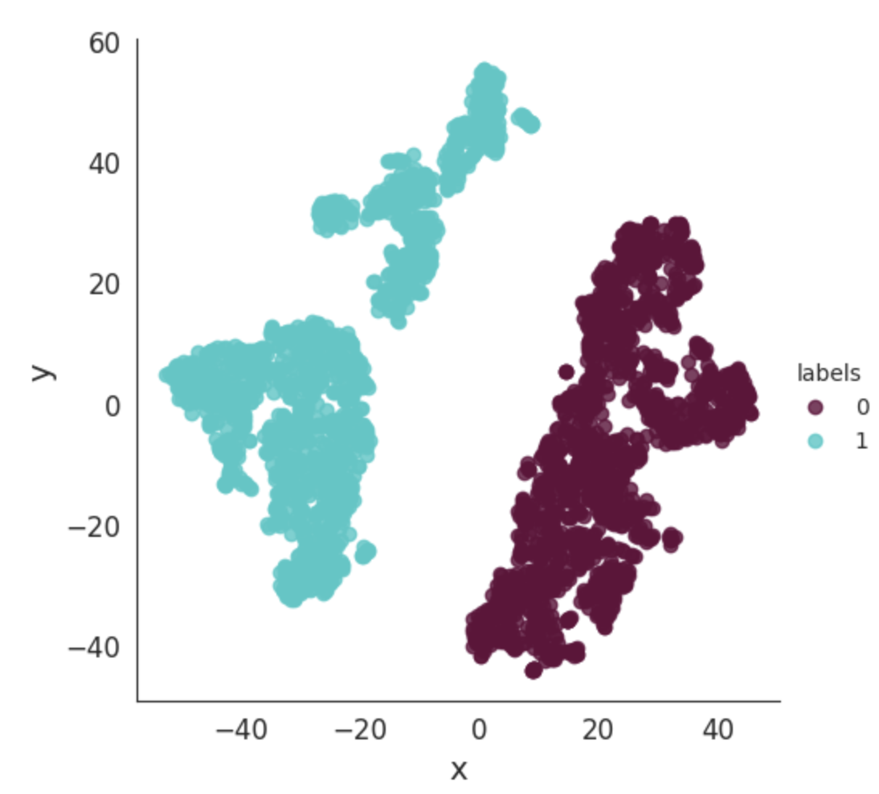
T-Distributed Stochastic Neighbor Embedding (TSNE)
Principal Component Analysis (PCA)

Slide 17
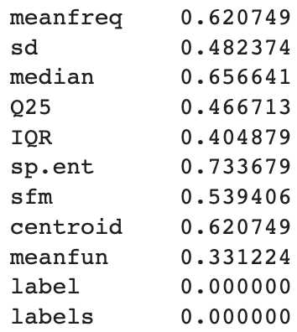
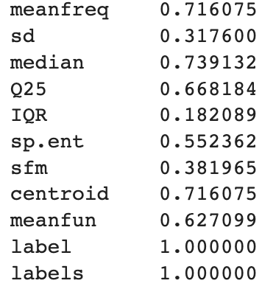
1584 Data Points
1584 Data Points

Slide 18
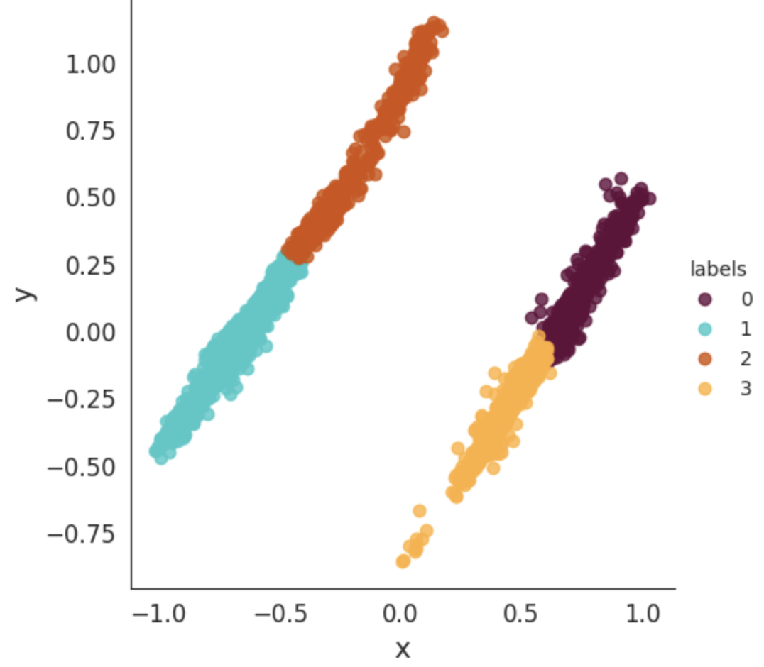
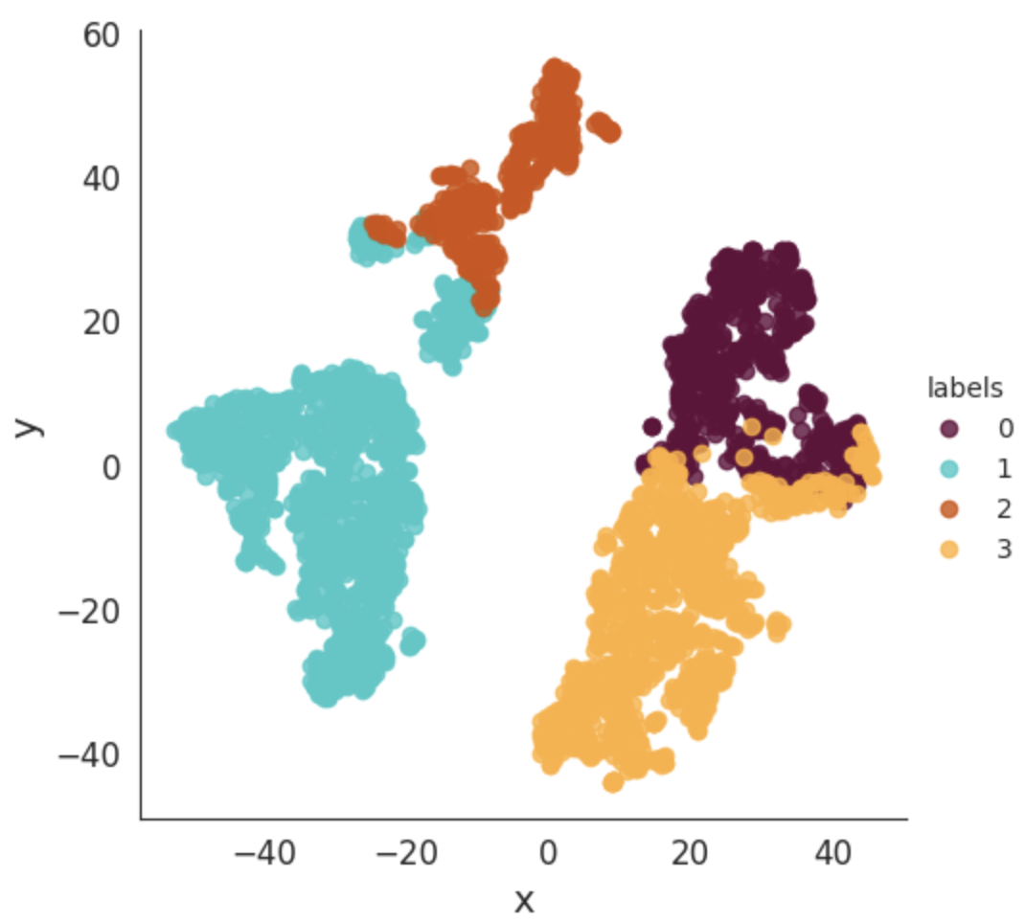
T-Distributed Stochastic Neighbor Embedding (TSNE)
Principal Component Analysis (PCA)

Slide 19
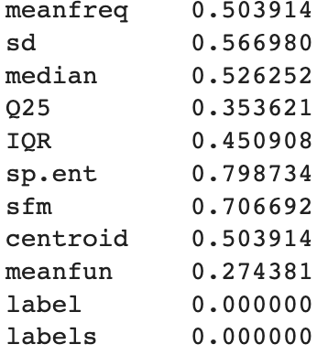
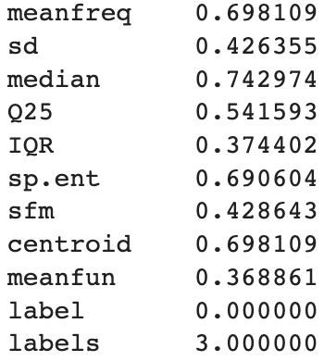
631 Data Points
953 Data Points

Slide 20
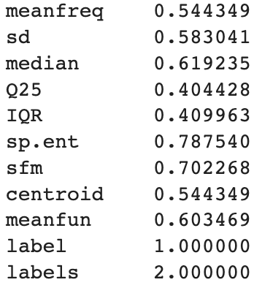
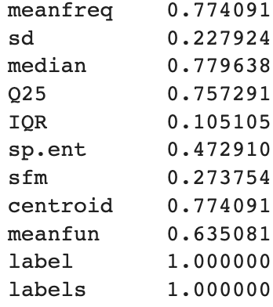
400 Data Points
1184 Data Points

Slide 21
What Does This Tell Us?
2 Clusters without genders
2 Clusters with genders
4 Clusters with genders
Higher STD in voice frequency for lower frequencies
Men have higher STD in their voice frequency
Each gender as a subgroup of low meanfreq with high STD, Spectral Entropy and Flatness. False
Spectral Entropy and Flatness is lower in HIgher mean freq
Women have a higher average of fundamental frequency

Slide 22
Decision Tree Analysis
What does the Decision Tree tell us about a how to determine a person’s gender from their voice?

Slide 23
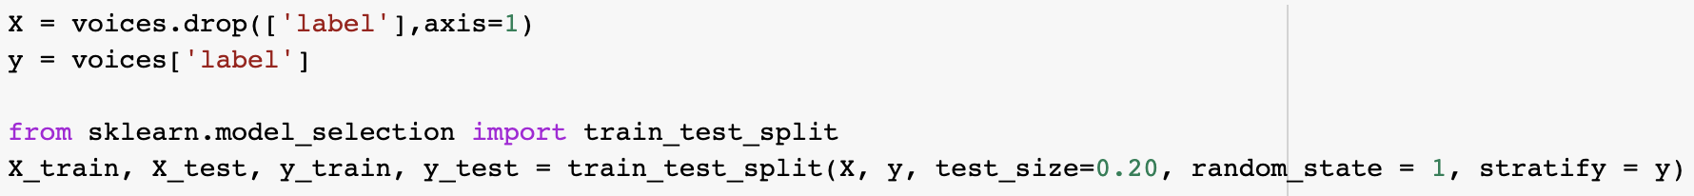
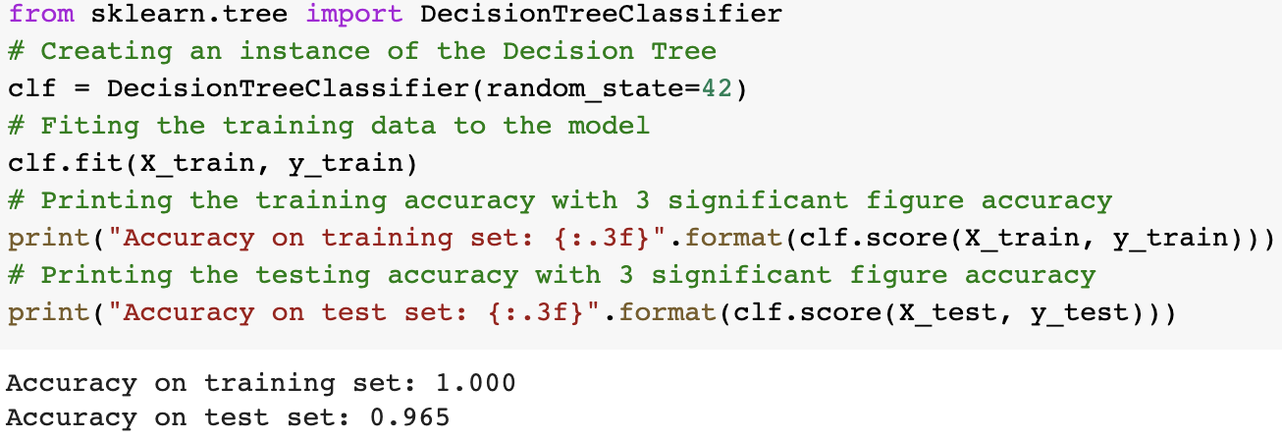
Standard Decision Tree Accuracy

Slide 24
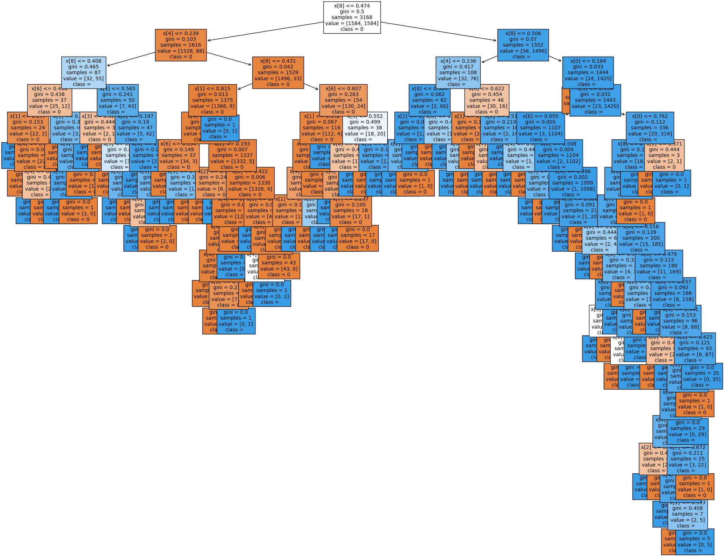

Slide 25
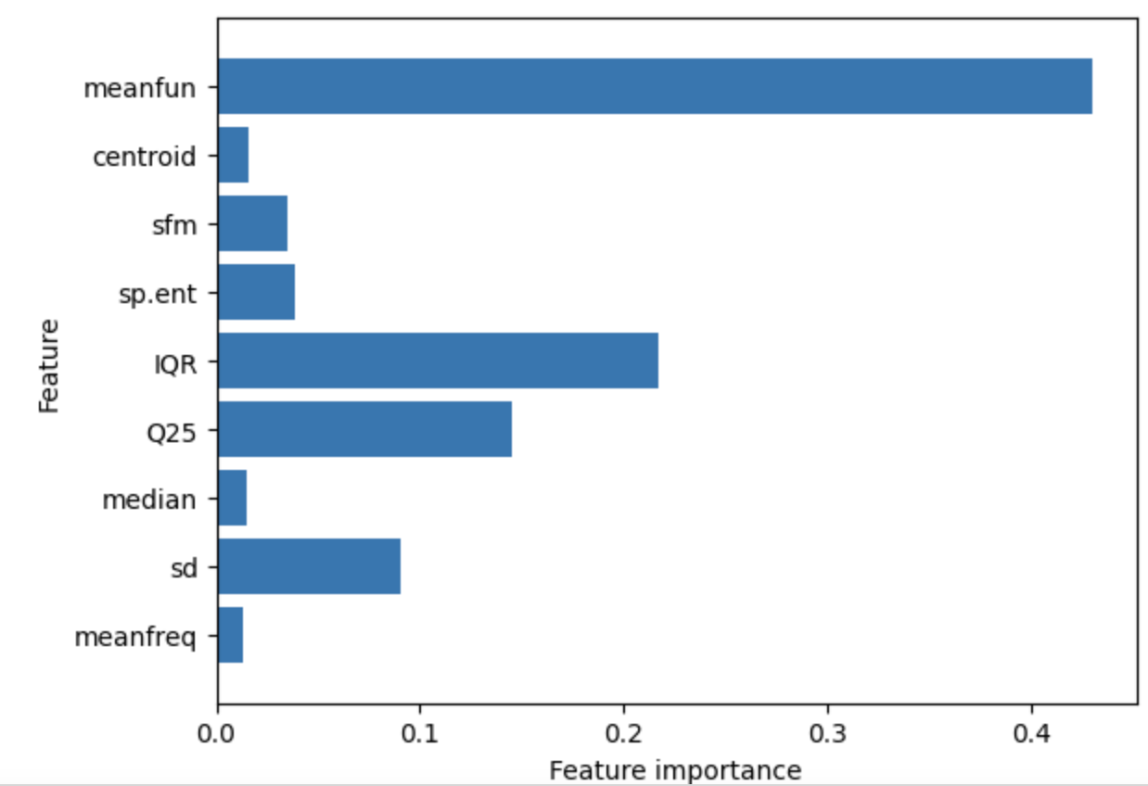
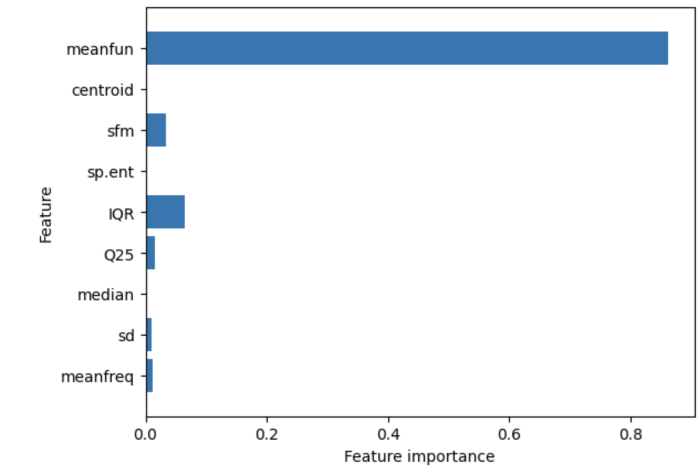
Random Forest
Decision Tree

Slide 26
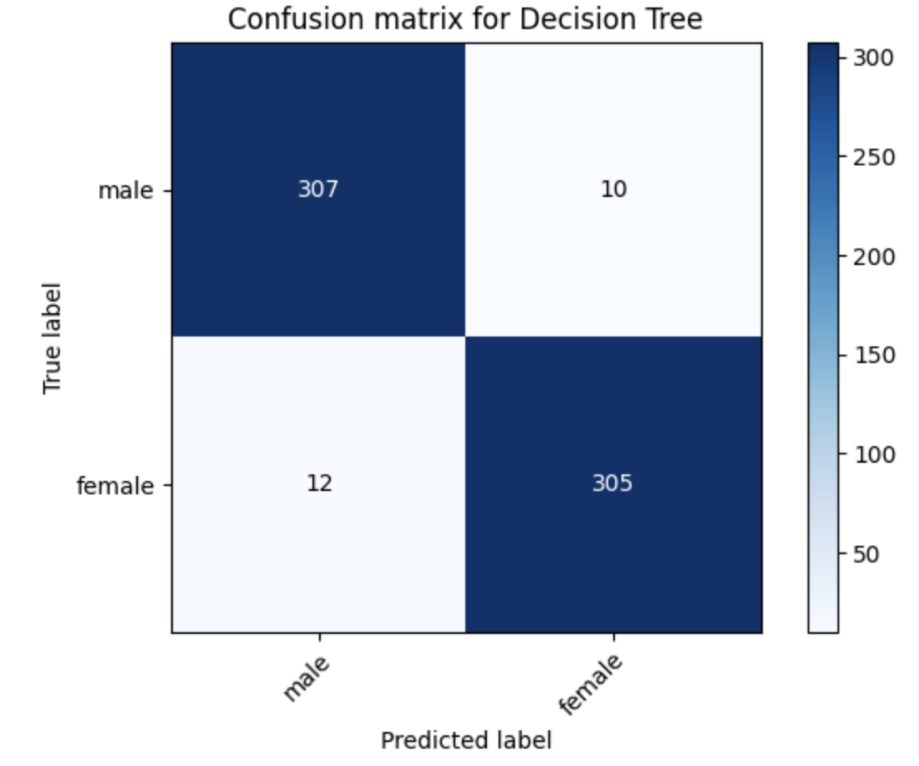

Slide 27
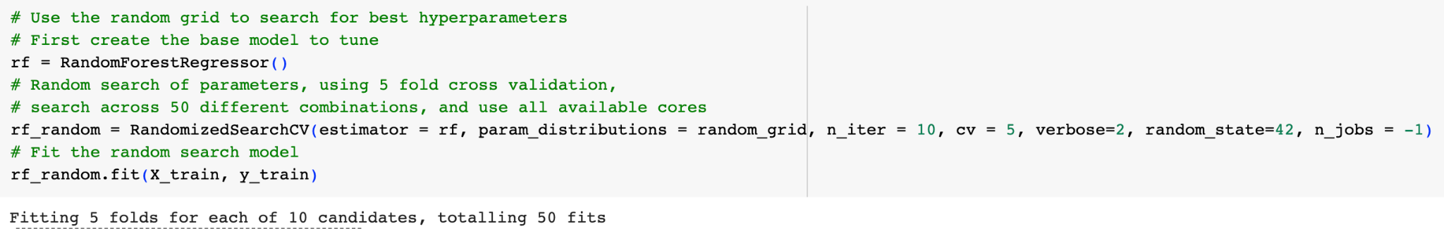
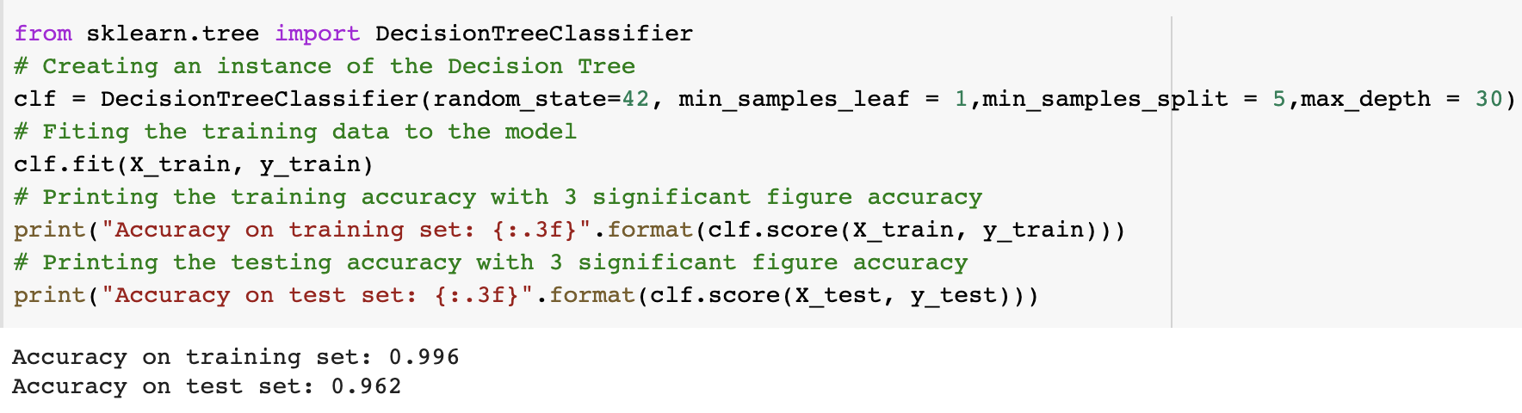
Hyperparameter Decision Tree Accuracy

Slide 28
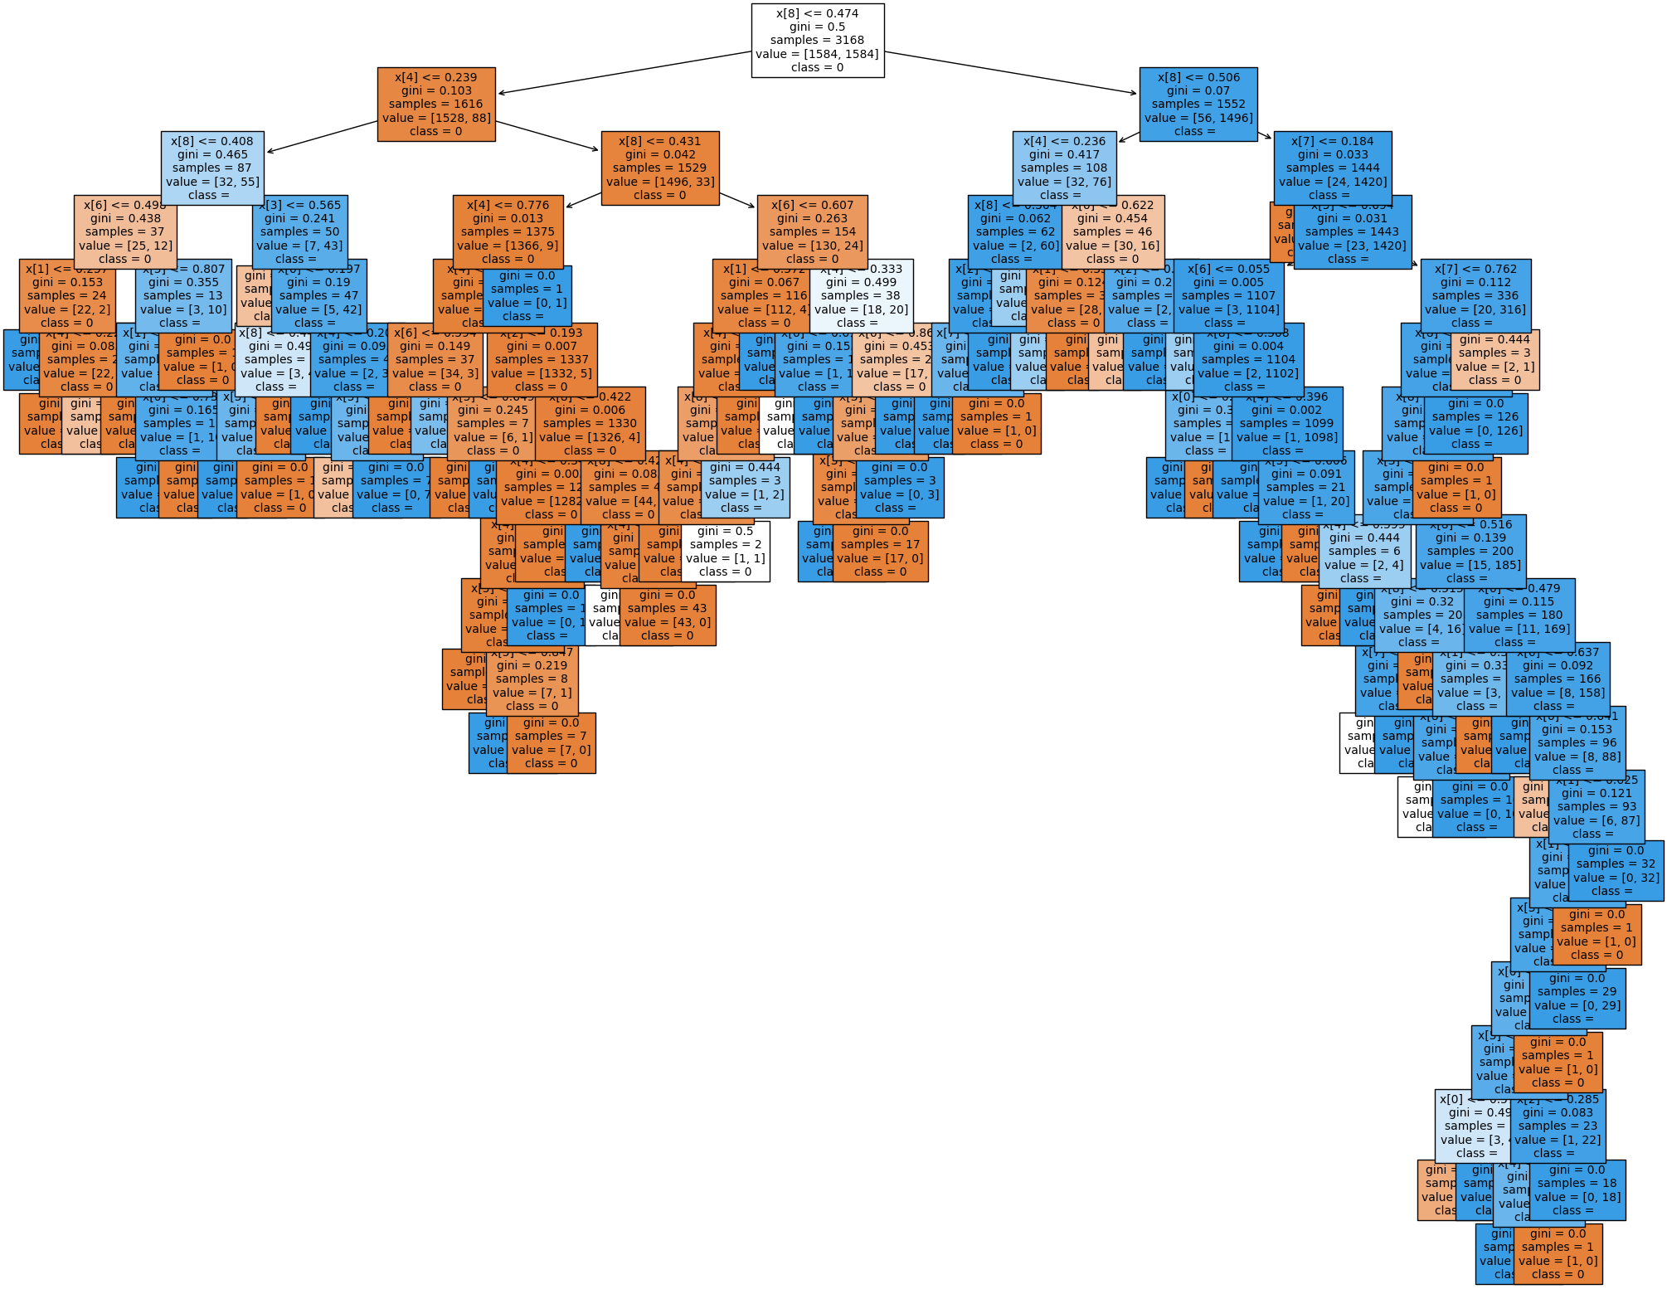

Slide 29
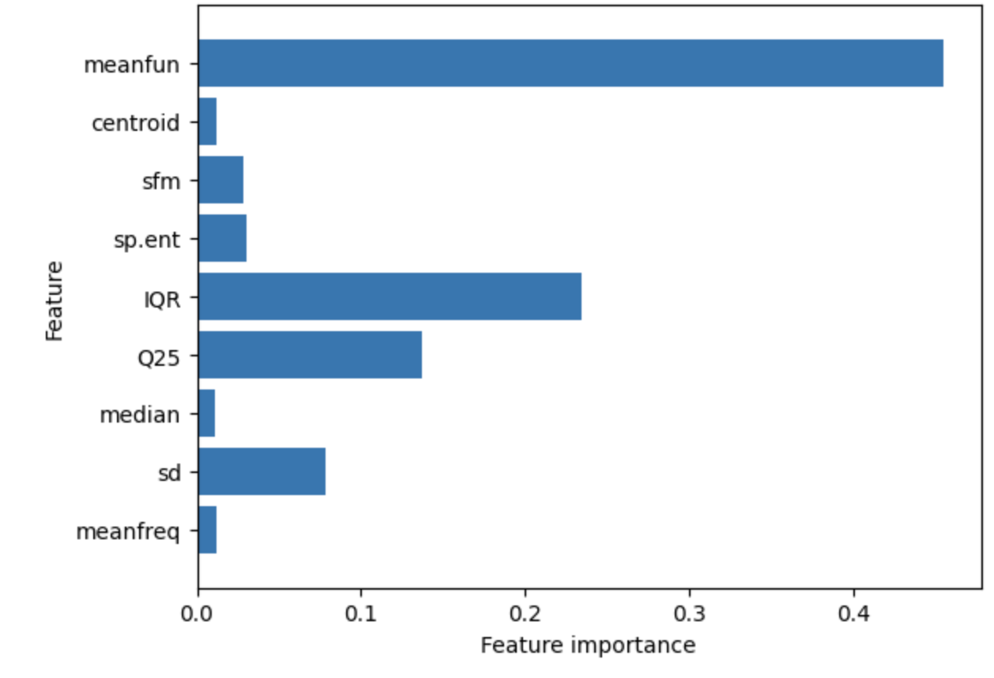
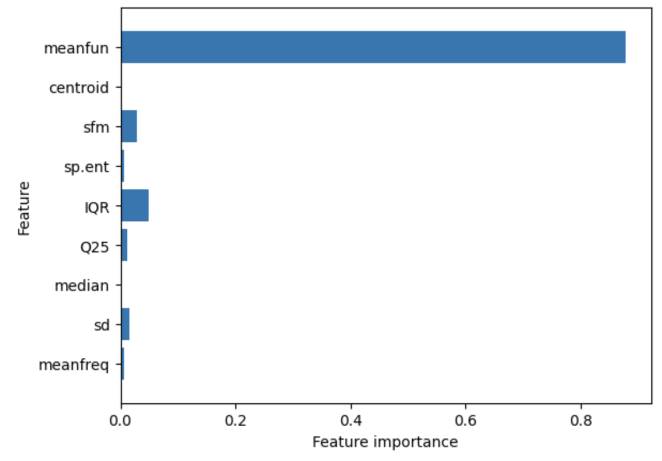
Random Forest
Decision Tree

Slide 30
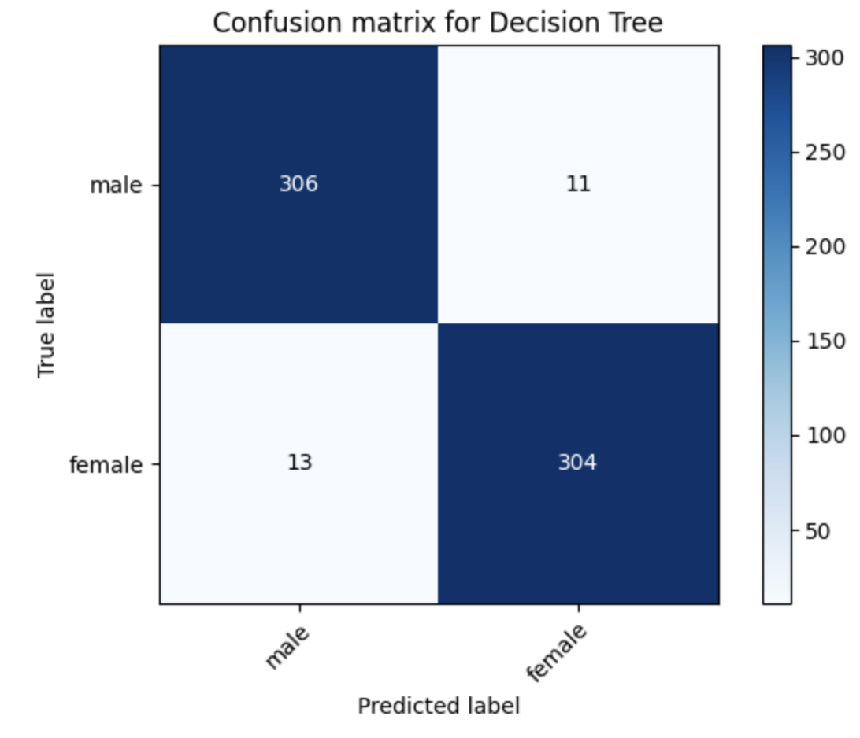

Slide 31
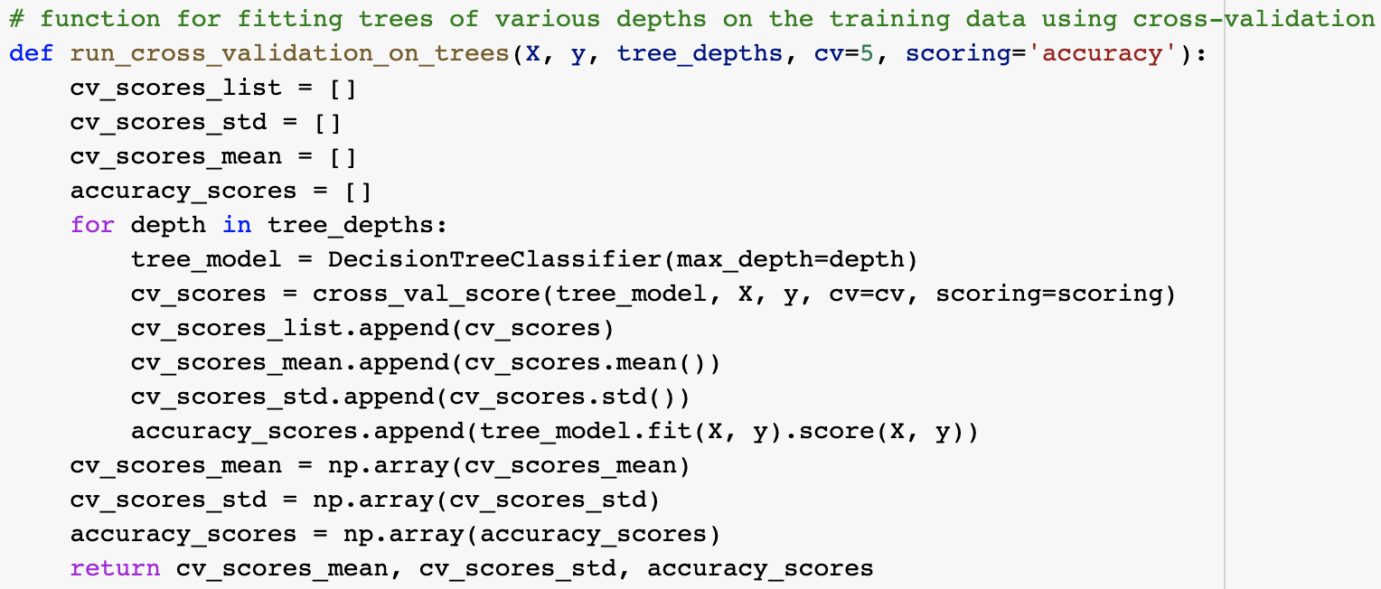
Limiting Max Depth Decision Tree

Slide 32
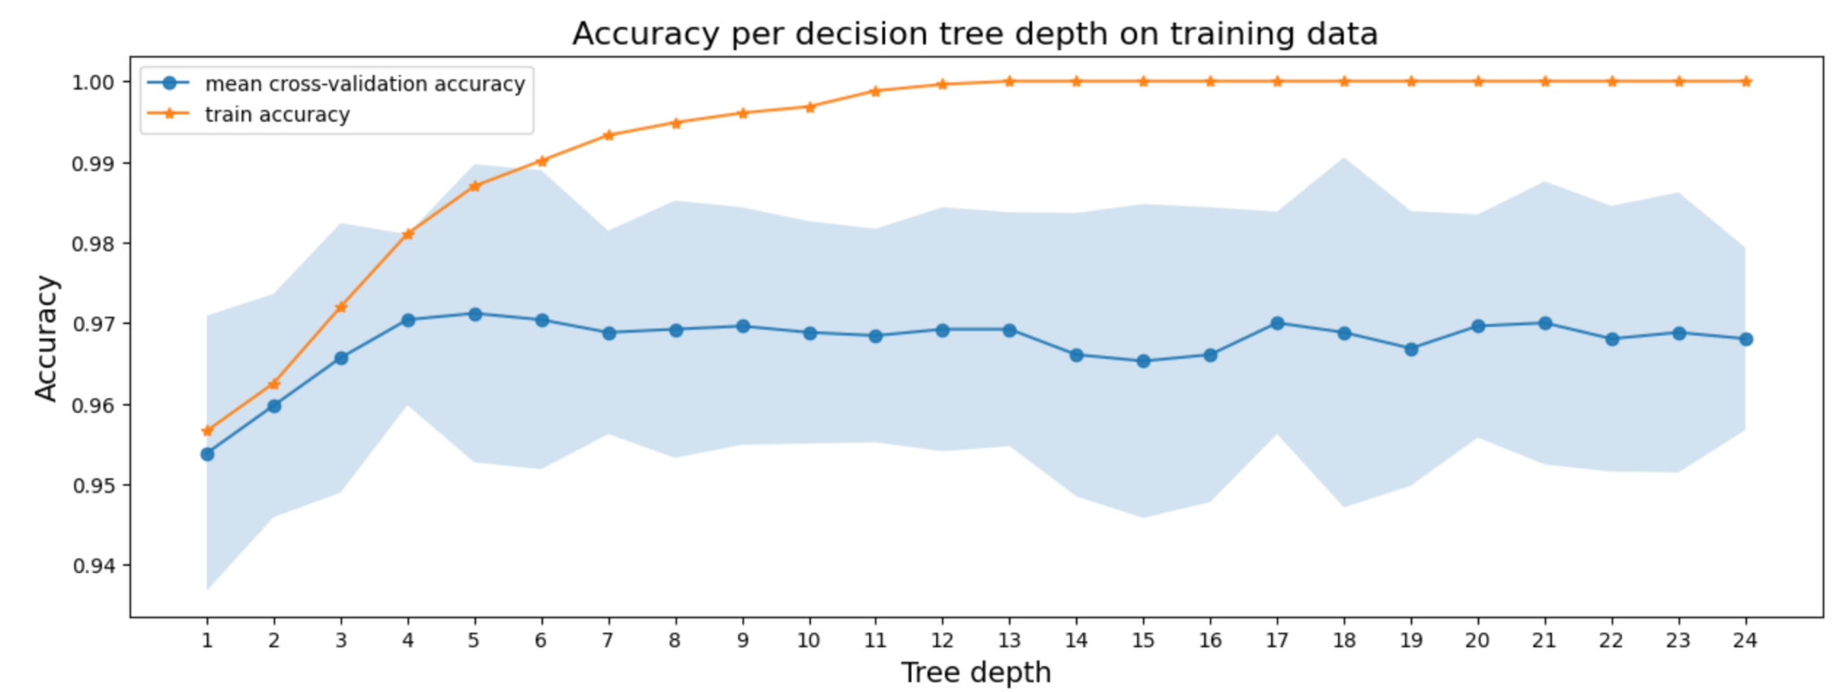
Max Depth Decision Tree CV Graph

Slide 33
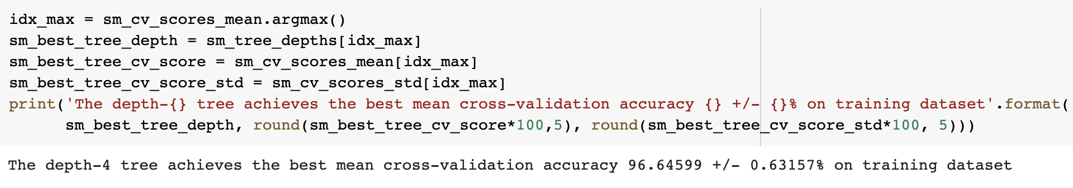
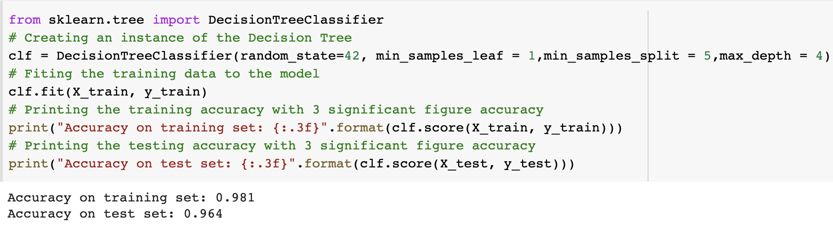
Limiting Max Depth Decision Tree

Slide 34
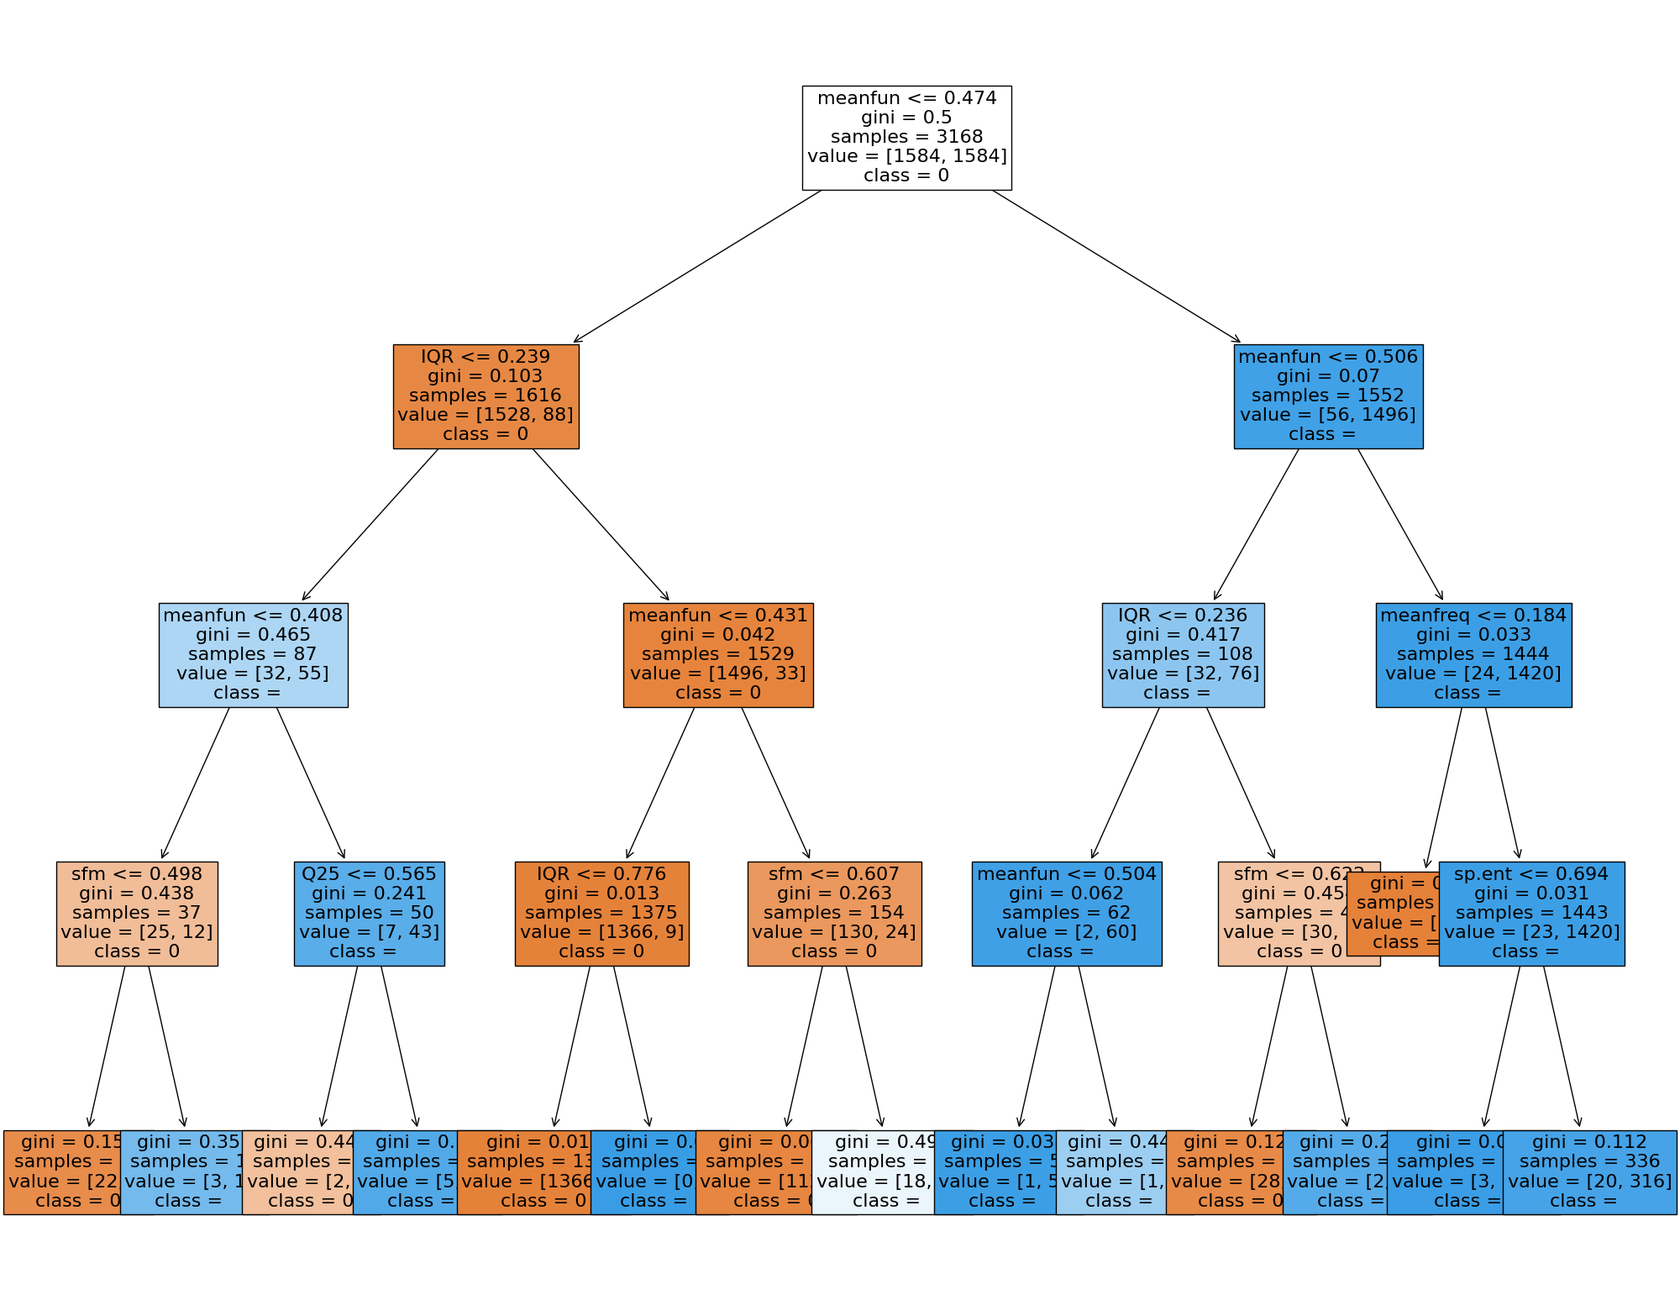

Slide 35
Random Forest
Decision Tree

Slide 36
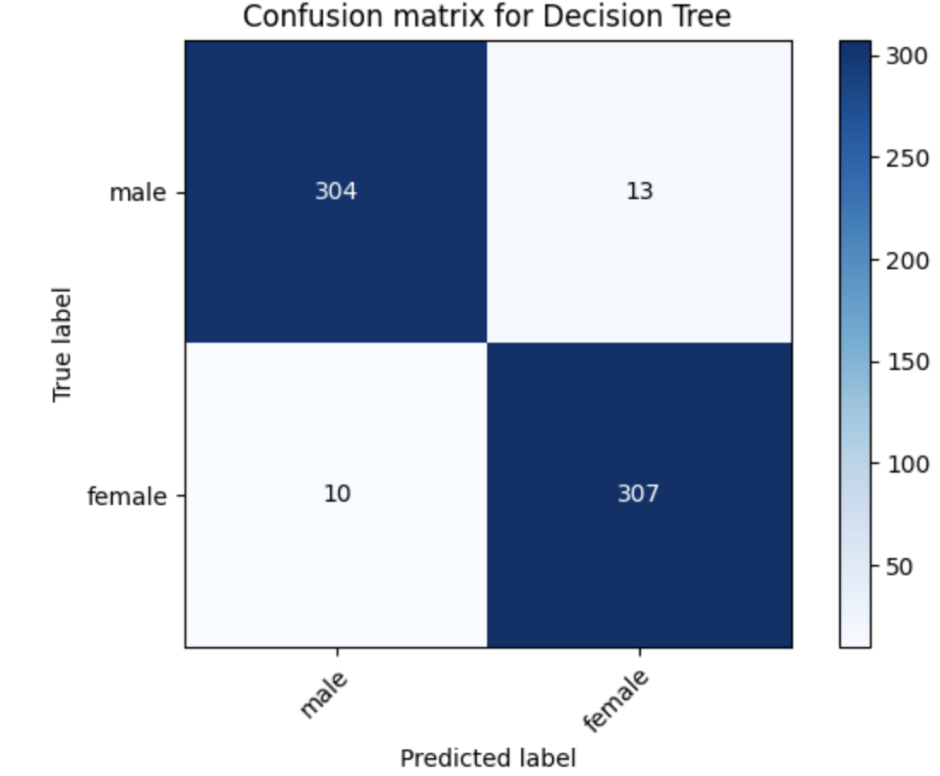

Slide 37
Conclusion
More Variables
Better Models
Age, accent, external and biological factors
Other models could find better success
More Data
Hard to Identify
Larger sample would of been helpful
It’s hard to identify an exception when you’re trying to not overfit

